Slide 1
Performance Analysis of Various Approaches to Parallel Computing
Erik Heaney
September 14, 2017
Oregon State University

Slide 2
Agenda
Introduction to Parallel Computing
Experimental Results
Implications for the industry

Slide 3
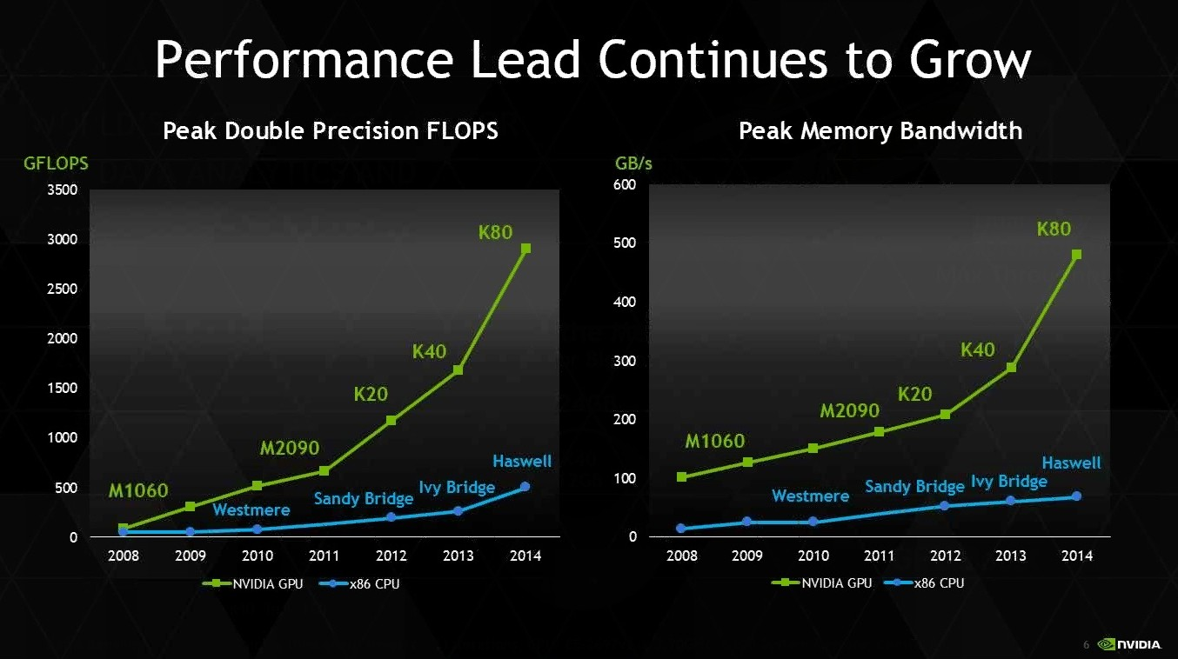
GPU Performance: Myth vs Reality

Slide 4
Introduction: Parallel Computing
Key to optimizing performance
Two types of parallelism:
Instruction parallelism
Data parallelism
Four approaches:
Multi-threading
SIMD
Clusters
GPGPU

Slide 5
Introduction: GPGPU
GPGPU: General Programming on GPUs
Primary APIs: NVidia's CUDA and OpenCL
No processor or control logic
Has no stack, so it does not support:
Recursion
Pointers
Function calls

Slide 6
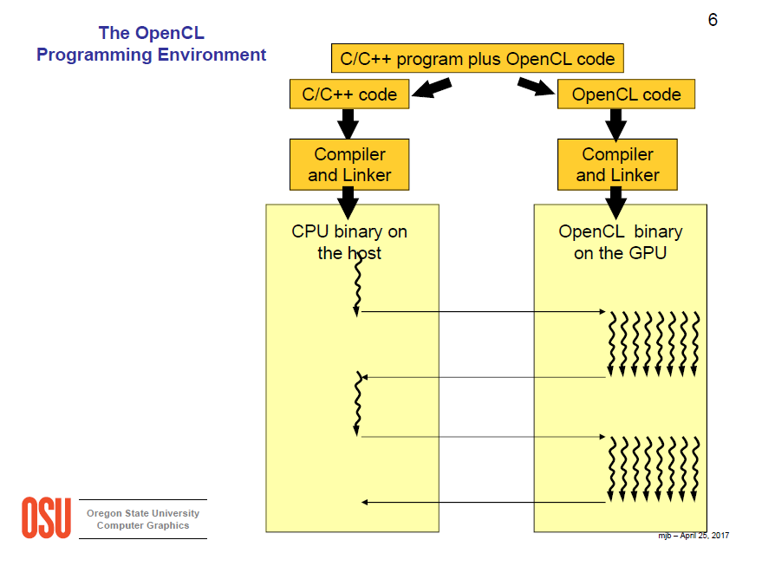
Introduction: GPGPU Compiling
1. Bailey, Michael. “The Open Computing Language (OpenCL)”, p 6. Oregon State University. CS-475: Parallel Programming. April 27, 2017.

Slide 7
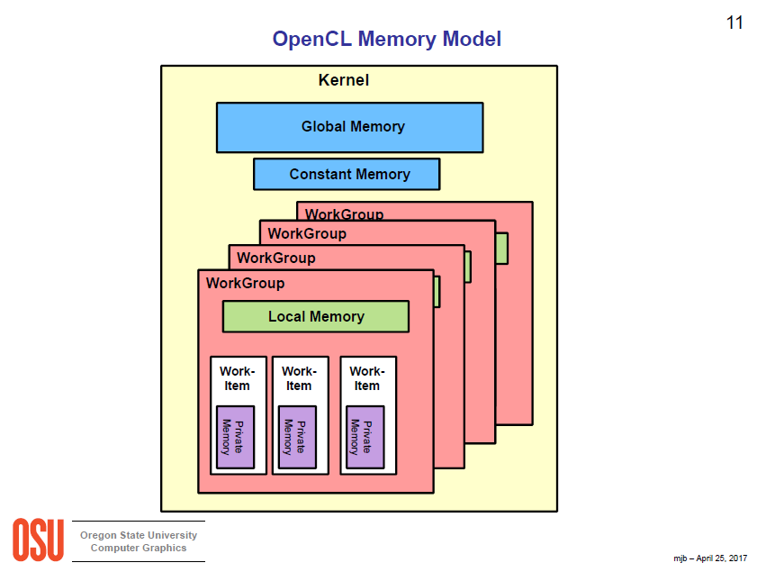
Introduction: GPU Architecture
2. Bailey, Michael. “The Open Computing Language (OpenCL)”, p 11. Oregon State University. CS-475: Parallel Programming. April 27, 2017.

Slide 8
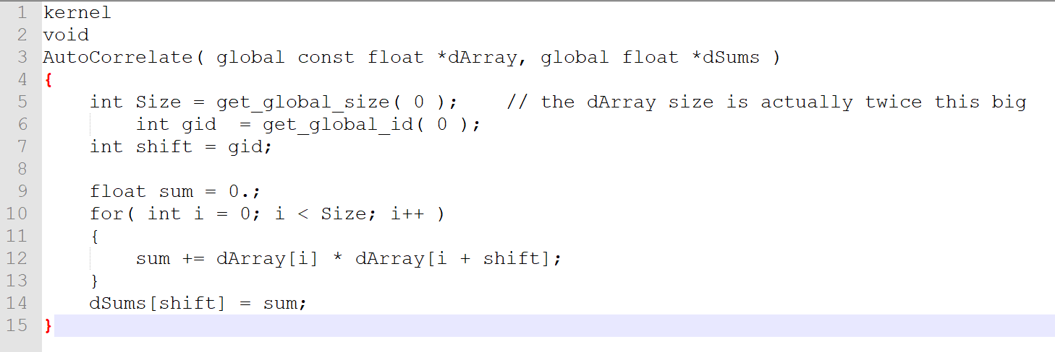
Introduction: OpenCL Code

Slide 9
Introduction: GPGPU APIs
Open-Standard
Cross-platform
Cross-compiler
Supports heterogeneous computing
C and C++
Cannot access hardware-specific technologies
Only for NVidia GPUs
CUDA is more mature
Debugger
Profiler
Compiler optimization
CUDA is more dominant
Just C++

Slide 10
Experimental Design
Control: A single-threaded process executed on a SISD CPU
Variables:
A multi-threaded process on a CISD CPU via OpenMP
A single-threaded process on a SIMD CPU via Intel SSE
A process on an NVidia GPU via OpenCL

Slide 11
Results
3. Heaney, Erik. “Autocorrelation using CPU OpenMP, CPU SIMD, and GPU OpenCL.” p 5. Oregon State University. June 13, 2017.

Slide 12
GPGPU Considerations
Dependent on computational task
Large datasets with repetitive tasks
Engineer must program to the GPU
Reduction: must reduce separate cores within each work group, then reduce the work groups in the CPU
Dynamic data structures, like linked lists and trees, must be flattened out into arrays
Expensive (Nvidia Titan Black: ~$2000)
GPUs are energy hogs

Slide 13
Implications for Scientific Computing
Rise of GPGPU cloud services
Development of bioinformatics CUDA APIs
GPU-BLAST⁴
CUDASW++⁵
GPUs particularly well-suited for:
Sequence alignment
Metagenomic classification
Molecular docking
5. Liu, Yongchao, Douglas L Maskell, and Bertil Schmidt. “CUDASW++: Optimizing Smith-Waterman Sequence Database Searches for CUDA-Enabled Graphics Processing Units.” BMC Research Notes 2 (2009): 73. PMC. Web. 13 Sept. 2017.
4. Vouzis, Panagiotis D., and Nikolaos V. Sahinidis. “GPU-BLAST: Using Graphics Processors to Accelerate Protein Sequence Alignment.” Bioinformatics 27.2 (2011): 182–188. PMC. Web. 13 Sept. 2017.
Notes:
The Smith-Waterman algorithm is more accurate than the BLAST algorithm, but is usually slower. GPU acceleration helps narrow this gap.

Slide 14
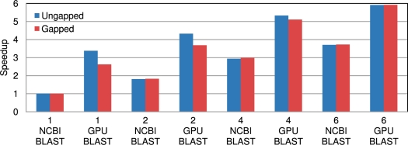
NCBI-BLAST vs GPU-BLAST Performance
4. Vouzis, Panagiotis D., and Nikolaos V. Sahinidis. “GPU-BLAST: Using Graphics Processors to Accelerate Protein Sequence Alignment.” Bioinformatics 27.2 (2011): 182–188. PMC. Web. 13 Sept. 2017.

Slide 15
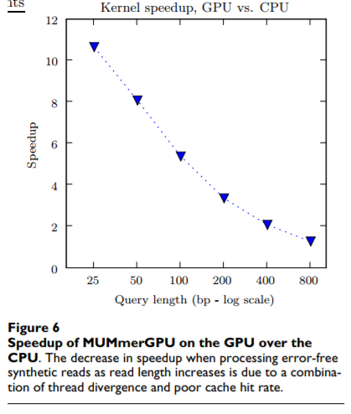
11x Speed Up of sequence alignment
6. Vouzis, Panagiotis D., and Nikolaos V. Sahinidis. “GPU-BLAST: Using Graphics Processors to Accelerate Protein Sequence Alignment.” Bioinformatics 27.2 (2011): 182–188. PMC. Web. 13 Sept. 2017.
Notes:
The test machine has a 3.0 GHz dual-core Intel Xeon 5160 with 2 GB of RAM, and an nVidia GeForce 8800 GTX. The 8800 GTX has 768 MB of on-board RAM and a G80 with 16 multiprocessors, each of which has 8 stream processors. At the time of this writing, the retail price of the 8800 GTX card is $529, and a retail-boxed Intel Xeon 5160 CPU is $882 [25]

Slide 16
Conclusion
Good for parallelizable problems
As GPU performance/cost ratio increases, expect to see more GPGPU in bioinformatics
Expect increased competition in GPU cloud services

Slide 17
Sources
1. Bailey, Michael. “The Open Computing Language (OpenCL)”, p 6. Oregon State University. CS-475: Parallel Programming. April 27, 2017.
2. Bailey, Michael. “The Open Computing Language (OpenCL)”, p 11. Oregon State University. CS-475: Parallel Programming. April 27, 2017.
3. Heaney, Erik. “Autocorrelation using CPU OpenMP, CPU SIMD, and GPU OpenCL.” p 5. Oregon State University. June 13, 2017.
4. Vouzis, Panagiotis D., and Nikolaos V. Sahinidis. “GPU-BLAST: Using Graphics Processors to Accelerate Protein Sequence Alignment.” Bioinformatics 27.2 (2011): 182–188. PMC. Web. 13 Sept. 2017.
5. Liu, Yongchao, Douglas L Maskell, and Bertil Schmidt. “CUDASW++: Optimizing Smith-Waterman Sequence Database Searches for CUDA-Enabled Graphics Processing Units.” BMC Research Notes 2 (2009): 73. PMC. Web. 13 Sept. 2017.
6. Schatz, Michael, Trapnell, Cole, Arther, Delcher, and Varshney, Amitabh. “High-throughput sequence alignment using Graphics Processing Units.” BMC Bioinformatics 8.474 (2007). Web. 13 Sept. 2017.

Slide 18
Thank you! Questions?

